Slide 1
PYTHON -2
PRITU A PATEL

Slide 2
What is KNN(K - NEAREST NEIGHBORS)?
K‑Nearest Neighbor (KNN) is a simple and widely used machine learning technique for classification and regression tasks.
It works by identifying the K closest data points to a given input and making predictions based on the majority class or average value of those neighbors.
Classifies data based on similarity with nearby data points
Uses distance metrics like Euclidean distance to find nearest neighbors
KNN is also called as a lazy learner algorithm because it does not learn from the training set immediately instead it stores the entire dataset and performs computations only at the time of classification.

Slide 3
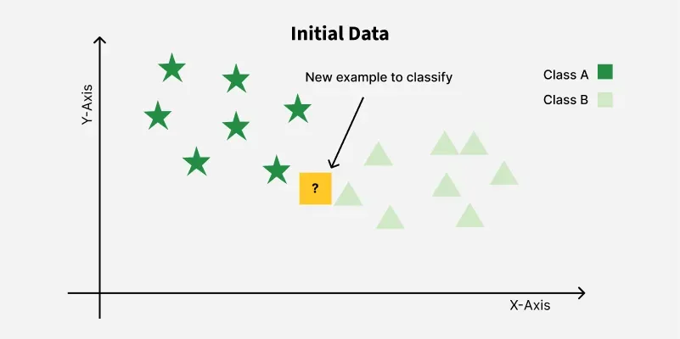
EXAMPLE

Slide 4
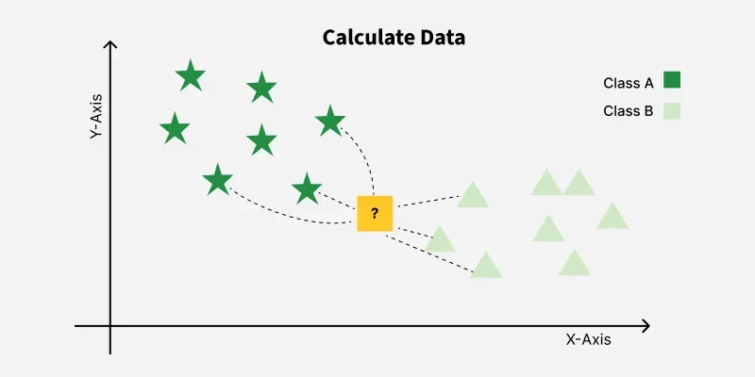
EXAMPLE

Slide 5
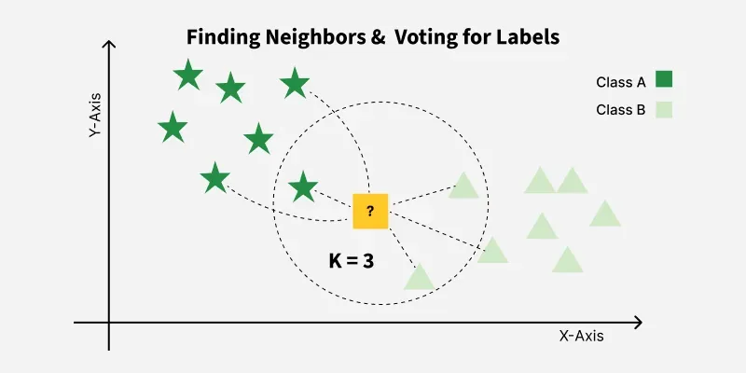
EXAMPLE

Slide 6
What is K in KNN?
In the KNN algorithm k is just a number that tells the algorithm how many nearby points or neighbors to look at when it makes a decision.
Example: Imagine you're deciding which fruit it is based on its shape and size. You compare it to fruits you already know.
If k = 3, the algorithm looks at the 3 closest fruits to the new one.
If 2 of those 3 fruits are apples and 1 is a banana, the algorithm says the new fruit is an apple because most of its neighbors are apples.
How to choose value of k in KNN?
K = number of nearest neighbors used for prediction
Small K → sensitive to noise (overfitting), Large K → too smooth (underfitting)
Odd Values for k: It’s a good idea to use an odd number for k especially in classification problems. This helps avoid ties when deciding which class is the most common among the neighbors.

Slide 7
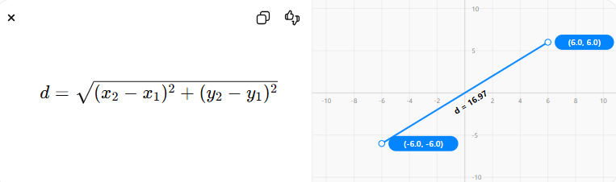
Distance Metrics used in KNN?
Euclidean Distance
Euclidean distance is defined as the straight-line distance between two points in a plane or space. You can think of it like the shortest path you would walk if you were to go directly from one point to another.

Slide 8
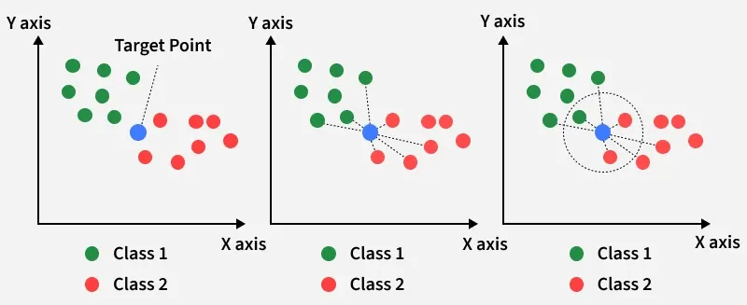
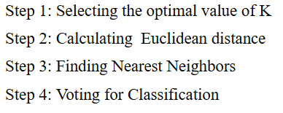
Working of KNN?

Slide 9
Implementing KNN
Step 1 : Import the Required Library
from sklearn.neighbors import KNeighborsClassifier
Step 2: Load the Dataset (csv file)
Step 3: Data Cleaning & EDA (if required)
Step 4: Feature Selection single x and y variable (for simple linear Regression)
multiple features selection x and single y variable(for multilinear Regression)
Step 5: Model Selection (Data Split on train and test data)
x_train,x_test,y_train,y_test = train_test_split(x,y,test_size=0.2,random_state = 10)

Slide 10
Implementing KNN
Step 6 : Train the knn Model with assigning n_neighbors
KNN = KNeighborsClassifier(n_neighbors=5)
KNN.fit(x_train,y_train)
Step 7: Make Prediction
y_pred = KNN .predict(x_test)

Slide 11
Model Evaluation for classification:
Confusion matrix :
The Confusion Matrix takes the classification results and groups them into four categories:
True Positive (TP): when both the actual and predicted values are 1.
True Negative (TN): when both the actual and predicted values are 0.
False Positive (FP): when the actual value is 0 but the predicted value is 1.
False Negative (FN): when the actual value is 1 but the predicted value is 0.
Example : Applied to our dataset, we get the following values:
True Positive (TP): 1
True Negative (TN): 14
False Positive (FP): 3
False Negative (FN): 2

Slide 12
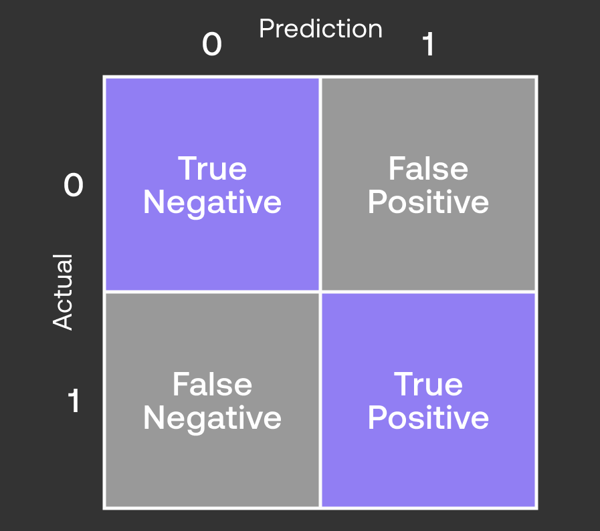
l Confusion Matrix:

Slide 13
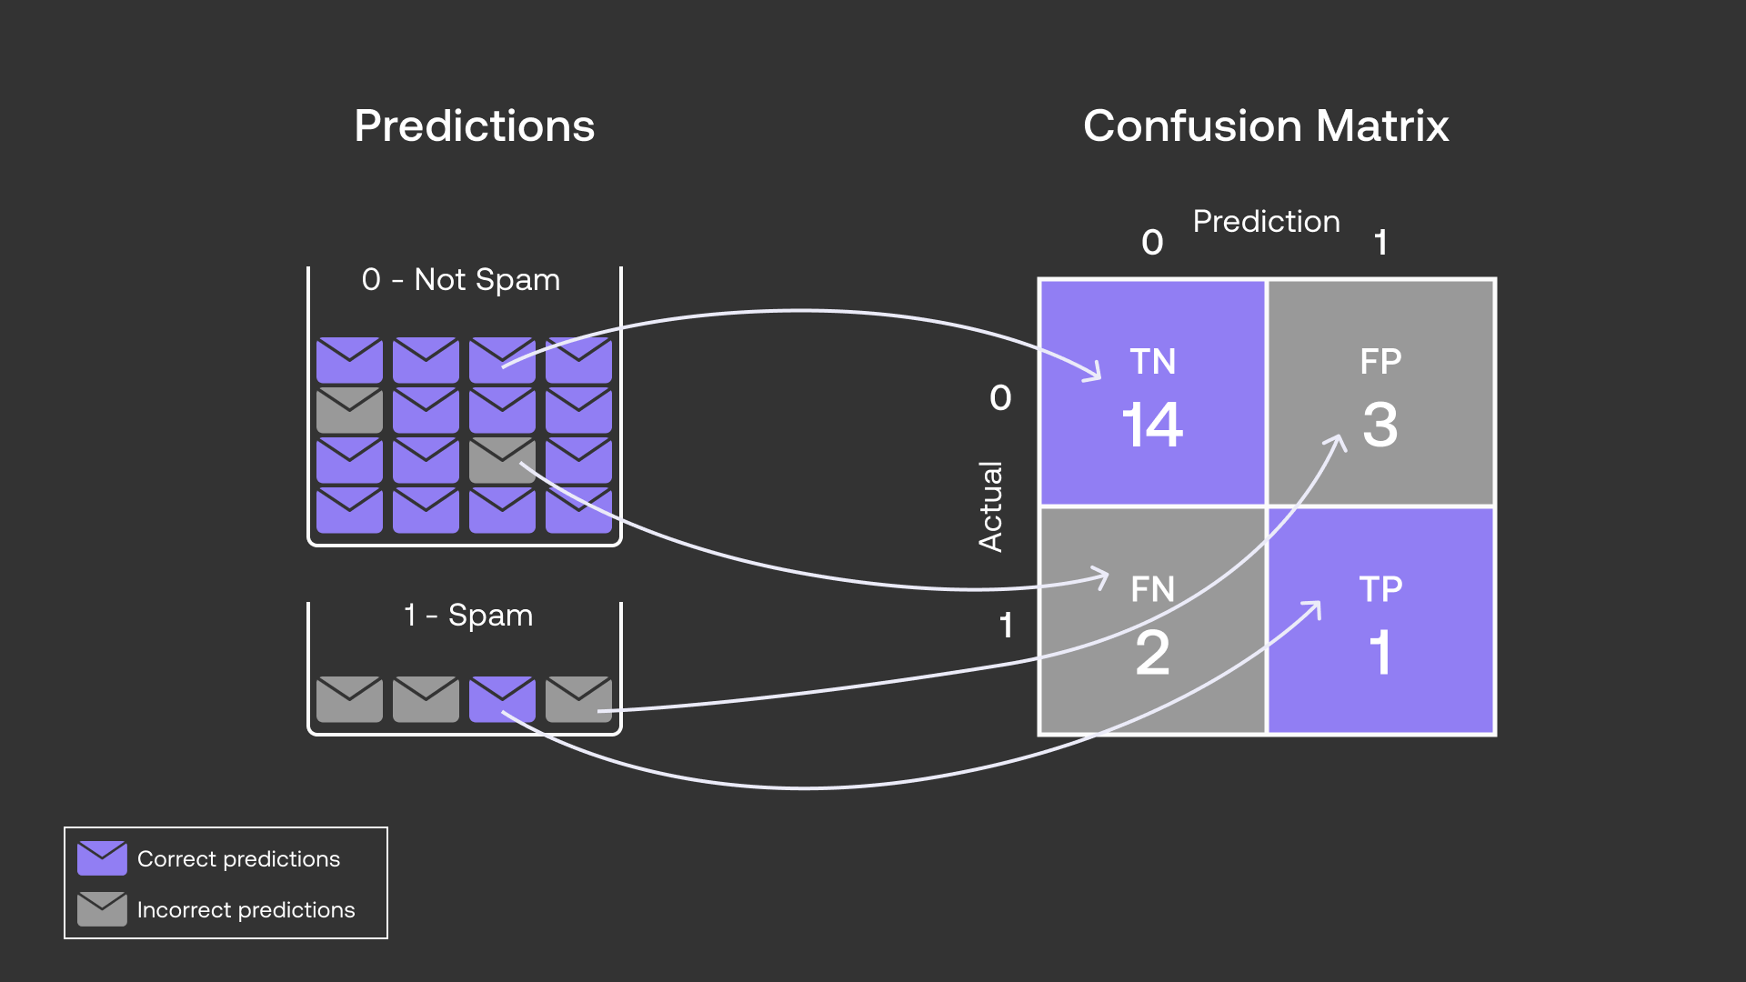
l. Confusion Matrix:

Slide 14
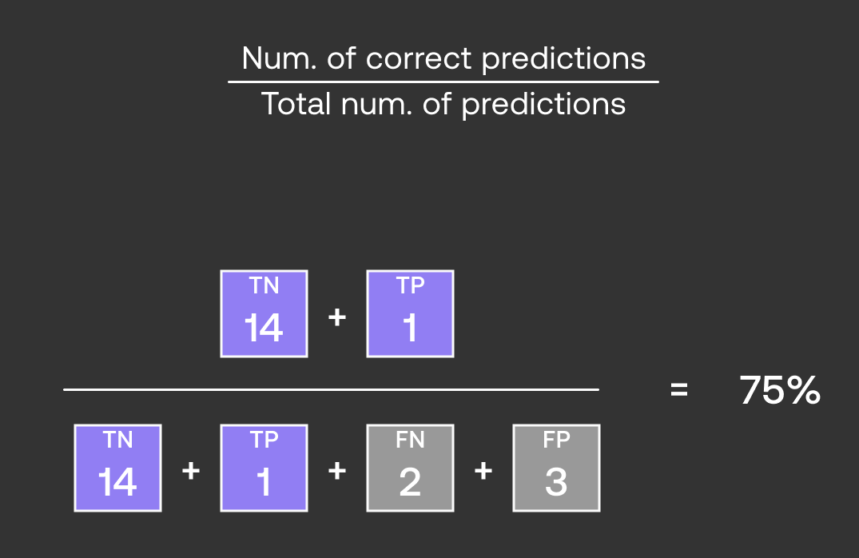
2. Accuracy Score:
Accuracy is a fundamental metric used for evaluating the performance of a classification model. It tells us the proportion of correct predictions made by the model out of all predictions.

Slide 15
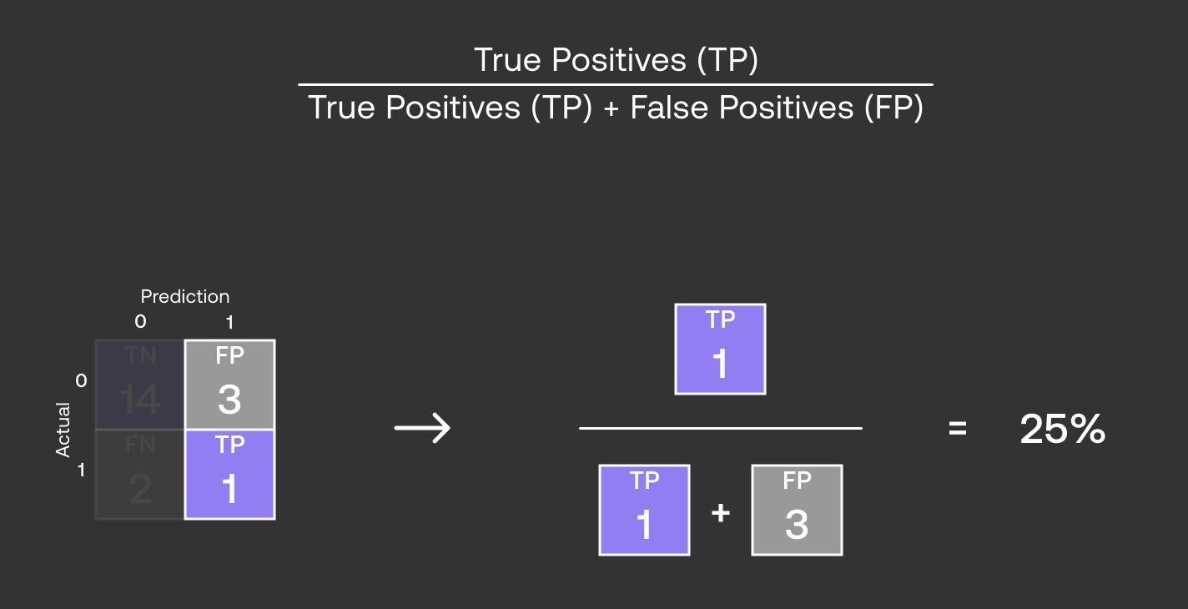
3. Precision score:
It measures how many of the positive predictions made by the model are actually correct. It's useful when the cost of false positives is high such as in medical diagnoses where predicting a disease when it’s not present can have serious consequences.

Slide 16
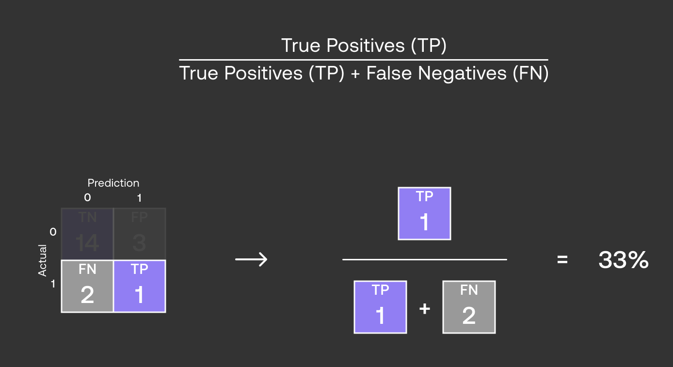
4. Recall Score :
Recall or Sensitivity measures how many of the actual positive cases were correctly identified by the model. It is important when missing a positive case (false negative) is more costly than false positives.

Slide 17
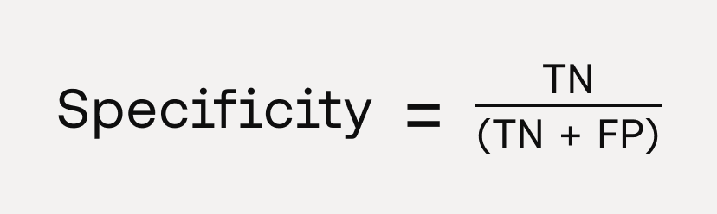
5. Specificity :
Specificity measures how many of the actual negative cases were correctly identified by the model

